Slide 1
Android Activity and Android Life-Cycle
Prodi Teknik Informatika
Fakultas Teknologi Informasi Universitas YARSI

Slide 2
Topics
Android Activity
Android Life Cycle

Slide 3
Android Activity
Android Activity and Android Life-Cycle

Slide 4
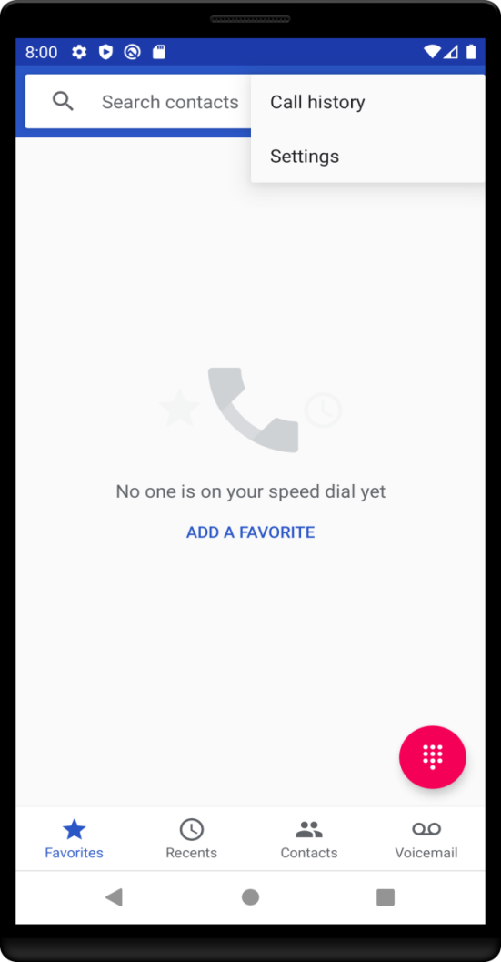
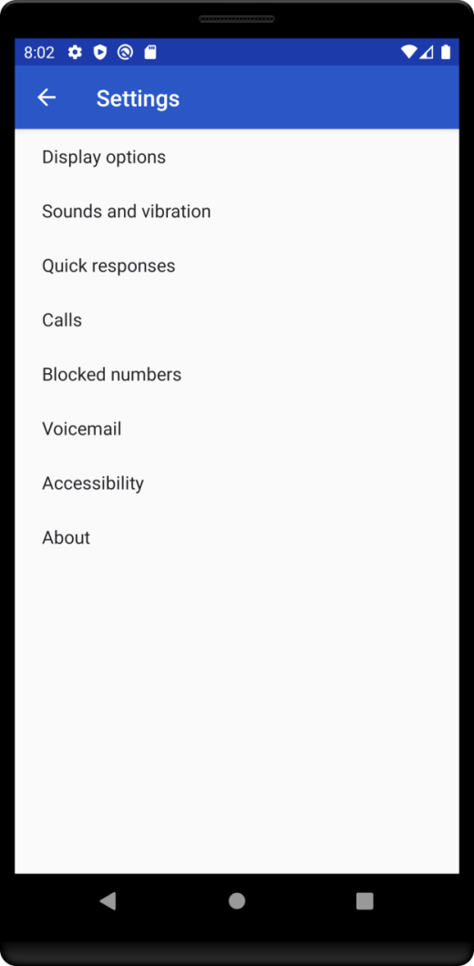
Android Activity Example
Components that display and organize the application pages as a place of interaction between users with Android apps. It represents a single screen with a user interface.
For example, an email app might have one activity that shows a list of new emails, another activity to compose an email, and another activity for reading emails.

Slide 5
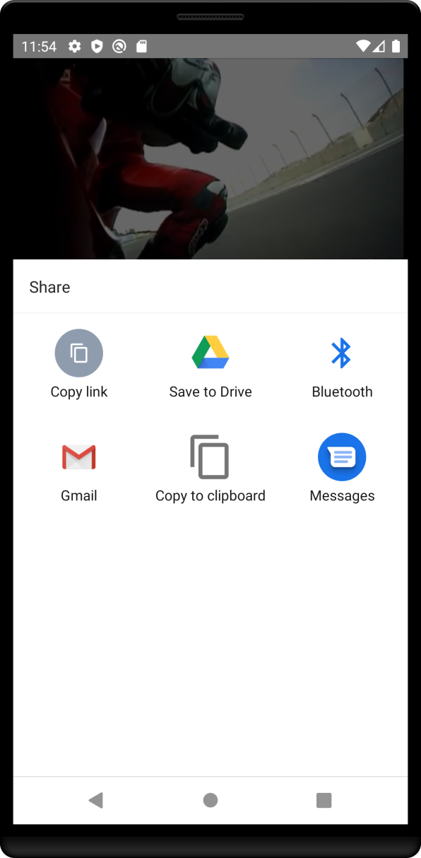
Android Activity
Although the activities work together to form a cohesive user experience in the email app, each one is independent of the others. As such, a different app can start any one of these activities if the email app allows it. For example, a camera app can start the activity in the email app that composes new mail to allow the user to share a picture.
Source: https://developer.android.com/guide/components/fundamentals

Slide 6
Activity Example

Slide 7
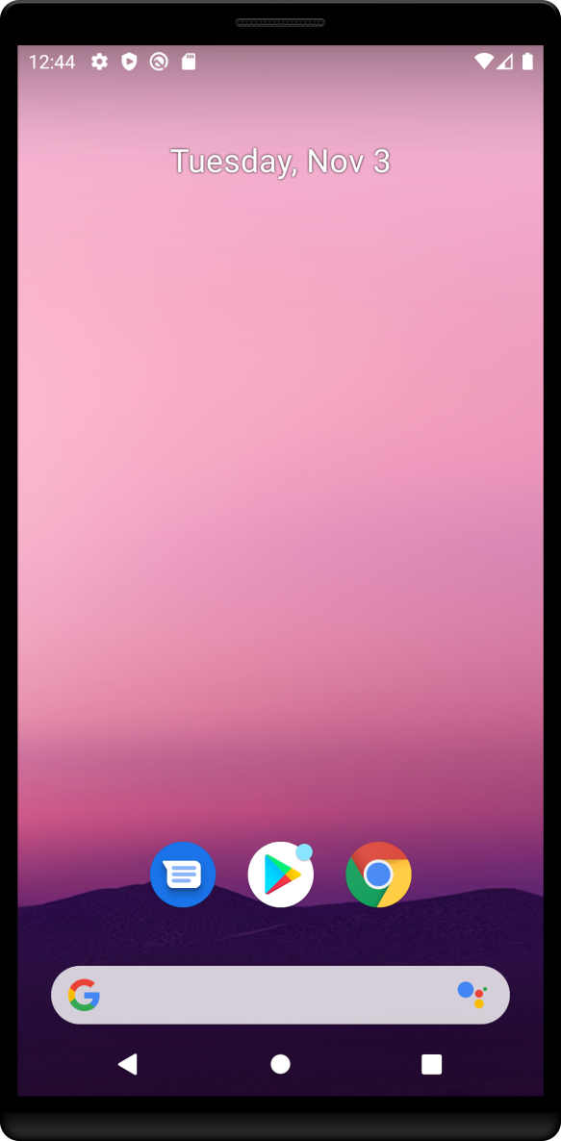
Setting Up Project
Table 2 Project Configuration
Template Category | Selected Option
Template Activity | ActivityExample
Name | ActivityExample
Package Name | com.example.activityexample
Save Location | -
Language | Kotlin
Minimum SDK | API 21: Android Lolipop (5.0)

Slide 8
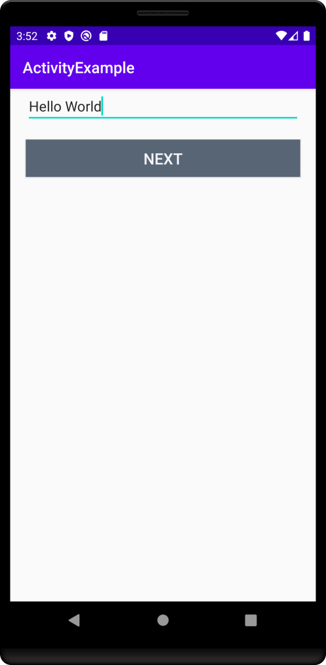
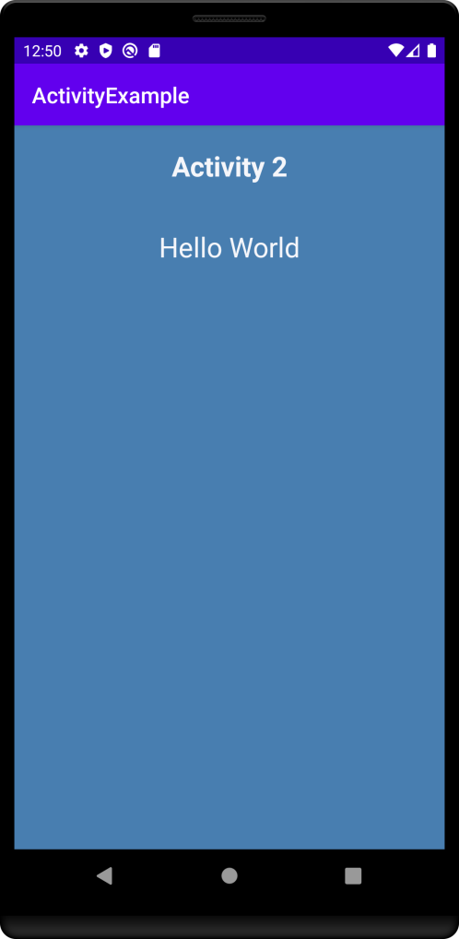
Activity Example: User Interface (UI)
Activity 1: MainActivity.kt
Activity 2: MainActivity2.kt
When user click Button Next

Slide 9
UI Code:activity_main.xml
activity_main.xml
<LinearLayout android:layout_width="match_parent" android:layout_height="match_parent" android:orientation="vertical"> <EditText android:id="@+id/editext_message" android:layout_width="match_parent" android:layout_height="wrap_content" android:layout_marginLeft="20dp" android:layout_marginRight="20dp"/>

Slide 10
UI Code:activity_main.xml
.../app/res/values/colors.xml
activity_main.xml
<resources>
<color name="buttonNext">#576574</color> <color name="buttonTextColor">#f5f6fa</color>
<resources>
...
<Button android:id="@+id/button_next" android:layout_width="match_parent" android:layout_height="wrap_content" android:text="Next" android:textSize="20sp" android:layout_margin="20dp" android:textColor="@color/buttonTextColor" android:background="@color/buttonNext"/> </LinearLayout>

Slide 11
MainActivity.kt
MainActivity.kt
const val MESSAGE = "MESSAGE"
class MainActivity : AppCompatActivity() { override fun onCreate(savedInstanceState: Bundle?) { super.onCreate(savedInstanceState) setContentView(R.layout.activity_main) button_next.setOnClickListener(View.OnClickListener { displayMessage(it) }) }

Slide 12
Kotlin Code: MainActivity.kt
MainActivity.kt
...
fun displayMessage(view: View){ var edittextMessage = editext_message.text.toString() var intent = Intent(this, MainActivity2::class.java).apply { putExtra(MESSAGE,edittextMessage) } startActivity(intent) // start new Activity }

Slide 13
UI Code:activity_main2.xml
activity_main.xml
<LinearLayout
android:layout_width="match_parent" android:layout_height="match_parent"
android:background="#487eb0" android:orientation="vertical" tools:layout_editor_absoluteX="16dp" tools:layout_editor_absoluteY="64dp">

Slide 14
UI Code:activity_main2.xml
activity_main.xml
<TextView android:id="@+id/textview_titleactivity" android:layout_width="match_parent" android:layout_height="wrap_content" android:layout_margin="20dp" android:gravity="center_horizontal" android:text="Activity 2" android:textColor="@color/buttonTextColor" android:textSize="25sp" android:textStyle="bold" />

Slide 15
UI Code:activity_main2.xml
activity_main.xml
<TextView android:id="@+id/textview_message " android:layout_width="match_parent" android:layout_height="wrap_content" android:layout_margin="20dp" android:gravity="center_horizontal" android:text="@string/display_message" android:textColor="@color/buttonTextColor" android:textSize="25sp" android:textStyle="bold" />
</LinearLayout>

Slide 16
Kotlin Code: MainActivity2.kt
MainActivity2.kt
class MainActivity2 : AppCompatActivity() {
override fun onCreate(savedInstanceState: Bundle?) { super.onCreate(savedInstanceState) setContentView(R.layout.activity_main2) displayMessage() } fun displayMessage(){ val displaymessage = intent.getStringExtra(MESSAGE).toString() textview_message.text = displaymessage }
}

Slide 17
Activity Declaration
AndroidManifest.xml
<manifest ... > <application ... > <activity android:name=".ExampleActivity" /> ... </application ... > ... </manifest >
To declare your activity, open your manifest file and add an <activity> element as a child of the <application> element.
You can also add attributes that define activity characteristics such as label, icon, or UI theme

Slide 18
Activity: Intent Filter
AndroidManifest.xml
<activity android:name=".ExampleActivity" android:icon="@drawable/app_icon"> <intent-filter> <action android:name="android.intent.action.SEND" /> <category android:name="android.intent.category.DEFAULT" /> <data android:mimeType="text/plain" /> </intent-filter> </activity>
Intent filters are a very powerful feature of the Android platform.
They provide the ability to launch an activity based not only on an explicit request, but also an implicit one.

Slide 19
Activity: Permission
AndroidManifest.xml
<manifest> <activity android:name="...." android:permission="com.google.socialapp.permission.SHARE_POST" />
.................................................................................
<manifest> <uses-permission android:name="com.google.socialapp.permission.SHARE_POST" /> </manifest>
You can use the manifest's <activity> tag to control which apps can start a particular activity.
If you declare a <uses-permission> element for a parent activity, each child activity must have a matching <uses-permission> element.

Slide 20
Activity: Call Activity
AndroidManifest.xml
val sendIntent = Intent().apply { action = Intent.ACTION_SEND type = "text/plain" putExtra(Intent.EXTRA_TEXT, textMessage) } startActivity(sendIntent)
The following code snippet shows how to call the activity described above:

Slide 21
Android Life-Cycle
Android Activity and Android Life-Cycle

Slide 22
Android Activity Life-Cycle
OnRestart()
User return to the activity
User navigate to the actiivity
Activity Launced
OnCreate()
OnStart()
OnResume()
Activity Running
OnPause()
OnStop()
OnDestroy()
Activity Shut Down
Another activity comes into the foreground
App process killed
User navigate to the actiivity
Apps with higher prority need memory
Source: https://developer.android.com/guide/components/activities/activity-lifecycle

Slide 23
Android Activity Life-Cycle
Activity Launced
OnCreate()
OnStart()
OnResume()
Activity Running
OnPause()
OnStop()
OnDestroy()
Activity Shut Down
Basic Application Startup Logic (Only once for the entire life of the activity)
Bind data to list
Instantiate class scope variables
Source: https://developer.android.com/guide/components/activities/activity-lifecycle

Slide 24
Android Activity Life-Cycle
Activity Launced
OnCreate()
OnStart()
OnResume()
Activity Running
OnPause()
OnStop()
OnDestroy()
Activity Shut Down
The activity is visible to user
The activity prepares for entering the foreground and become interactive
Source: https://developer.android.com/guide/components/activities/activity-lifecycle

Slide 25
Android Activity Life-Cycle
Activity Launced
OnCreate()
OnStart()
OnResume()
Activity Running
OnPause()
OnStop()
OnDestroy()
Activity Shut Down
App interacts with the user.
The app stays in this state until user navigating to another activity or an event might be for instance, receiving a call.
Source: https://developer.android.com/guide/components/activities/activity-lifecycle

Slide 26
Android Activity Life-Cycle
Activity Launced
OnCreate()
OnStart()
OnResume()
Activity Running
OnPause()
OnStop()
OnDestroy()
Activity Shut Down
App enters this state when the user is leaving the activity
This is where the lifecycle components can stop any functionality that does not need to run while the component is not in the foreground, such as stopping a camera preview.
Source: https://developer.android.com/guide/components/activities/activity-lifecycle

Slide 27
Android Activity Life-Cycle
Activity Launced
OnCreate()
OnStart()
OnResume()
Activity Running
OnPause()
OnStop()
OnDestroy()
Activity Shut Down
App enters this state when the activity is no longer visible to user (e.g when a newly launched activity covers the entire screen).
This is where the lifecycle components can stop any functionality that does not need to run while the component is not visible on the screen.
to perform relatively CPU-intensive shutdown operations.
For example, if you can't find a more opportune time to save information to a database, you might do so during onStop()
Source: https://developer.android.com/guide/components/activities/activity-lifecycle

Slide 28
Android Activity Life-Cycle
Activity Launced
OnCreate()
OnStart()
OnResume()
Activity Running
OnPause()
OnStop()
OnDestroy()
Activity Shut Down
The final call you receive before your activity is destroyed. This can happen either because the activity is finishing (someone called Activity#finish on it),
or because the system is temporarily destroying this instance of the activity to save space.
Source: https://developer.android.com/guide/components/activities/activity-lifecycle

Slide 29
Activity state and ejection from memory
Table. 1 Relationship between process life-cycle and activity state
Likelihood of being killed | Process state | Activity state
Least | Foreground (having or about to get focus) | Created
 |  | Started
 |  | Resumed
More | Background (lost focus) | Paused
Most | Background(not visible) | Stopped
 | Empty | Destroyed
Source: https://developer.android.com/guide/components/activities/activity-lifecycle

Slide 30
Android Life-Cycle Example

Slide 31
Override activity state function
const val ACTIVITY_NAME = "ACTIVITY 1"
class MainActivity : AppCompatActivity() { override fun onCreate(savedInstanceState: Bundle?) { super.onCreate(savedInstanceState) setContentView(R.layout.activity_main) button_next.setOnClickListener(View.OnClickListener { val intent = Intent(this, SecondActivity::class.java) startActivity(intent) }) }

Slide 32
Override activity state function
override fun onStart() { Toast.makeText(this, "$ACTIVITY_NAME enters onStart state", Toast.LENGTH_LONG).show() super.onStart() } override fun onResume() { Toast.makeText(this, "$ACTIVITY_NAME enters onResume state", Toast.LENGTH_LONG).show() super.onResume() }

Slide 33
Override activity state function
override fun onPause() { Toast.makeText(this, "$ACTIVITY_NAME enters onPaused state",Toast.LENGTH_LONG).show() super.onPause() } override fun onStop() { Toast.makeText(this, "$ACTIVITY_NAME enters onStop state", Toast.LENGTH_LONG).show() super.onStop() }

Slide 34
Override activity state function
override fun onDestroy() { Toast.makeText(this, "$ACTIVITY_NAME enters onDestroy state", Toast.LENGTH_LONG).show() super.onDestroy() } }

Slide 35
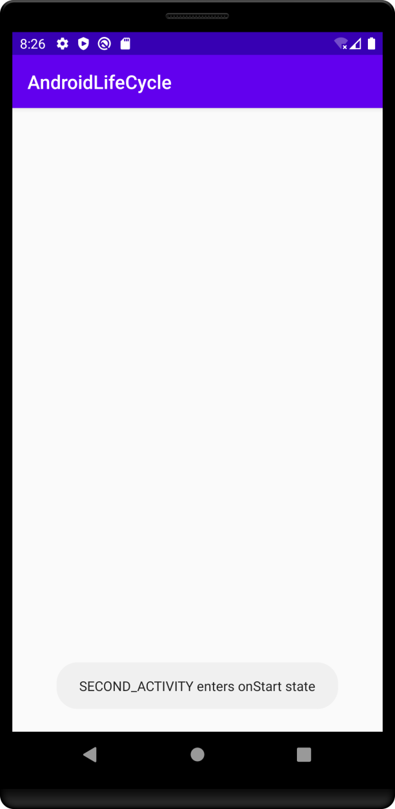
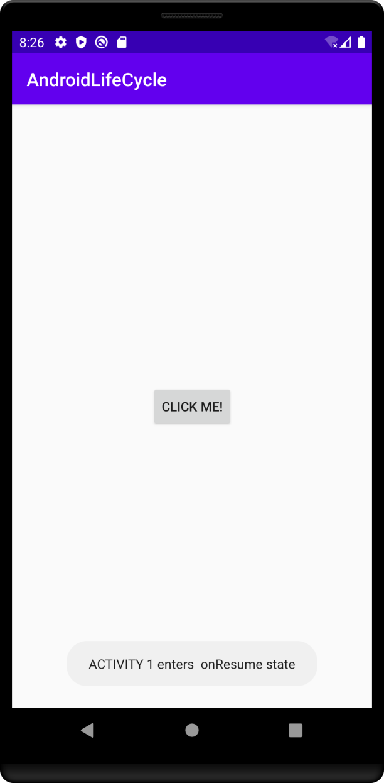
App: Run
See the demo application on the following link:
https://layar.yarsi.ac.id/mod/resource/view.php?id=35556

Slide 36
Questions ?

Slide 38
Muhamad Fathurahman, M.Kom

Slide 40
Muhamad Fathurahman
-

